Slide 1
Lecture 4 Parameteric Regression
Abrar Hasan
Lecturer
Dept. of Software Engineering

Slide 2
1
Parametric Regression
<
T
1
>

Slide 3
Parametric Regression
<
T
1
>
Parametric regression is a type of regression analysis where we assume that the relationship between the independent variables (predictors) and the dependent variable (target) can be modeled by a specific functional form, typically characterized by a finite set of parameters.

Slide 4
Parametric Regression
<
T
1
>
r = f (x)
e.g, r = mX + c
This can be written as
r = θ * X + c

Slide 5
Parametric Regression
<
T
1
>
θ * X + c Can be written as g(x| θ)

Slide 6
Parametric Regression
<
T
1
>
r = f (x) + ϵ
If we assume the noise to be gaussian, then we can model this Like a normal distribution with mean 0 with variance sigma²
ϵ ∼ N (0, σ²)

Slide 7
Parametric Regression
<
T
1
>
So the probability of Getting r from input X is
p(r∣x) ∼ N (g(x∣θ), σ²)

Slide 8
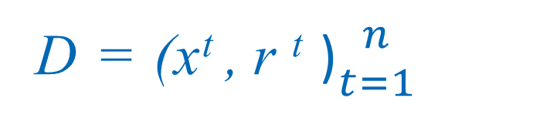
Parametric Regression
<
T
1
>
Suppose we have a data set D. In dataset there is independent x, and dependent r
D = (x^{t} , r ^{t} )${n \atop t=1}$
X₁ | R₁
X₂ | R₂
X₃ | R₃
X₄ | R₄
X₅ | R₅

Slide 9
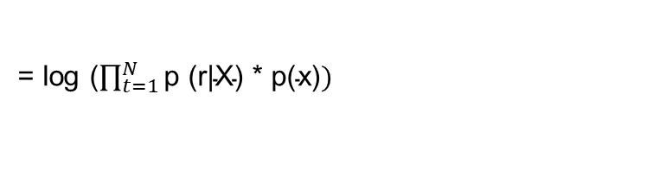
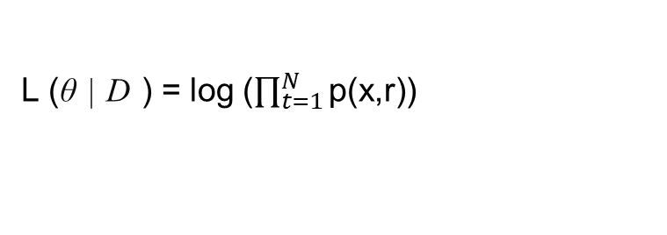
Parametric Regression
<
T
1
>
We Know Joint Probability is P(x,r). Probability occurring the x and r together.
p(x,r) = p (r|X) * p(x)
So, Log Likelihood is (Predicting the θ for our dataset D )
L (θ | D ) = log ($\prod_{t=1}^{N}{\text{p}\text{(}\text{x}\text{,}\text{r}\text{)) }}$
= log ($\prod_{t=1}^{N}{\text{p}\text{ (}\text{r}\text{|}\text{X}\text{) ∗ }\text{p}\text{(}\text{x}\text{)})}$

Slide 10
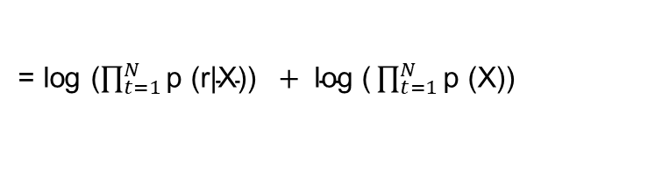
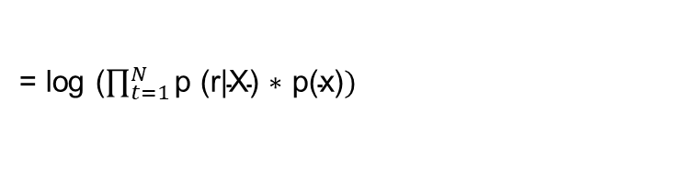

Parametric Regression
<
T
1
>
L (θ | D ) = log ($\prod_{t=1}^{N}{\text{p}\text{(}\text{x}\text{,}\text{r}\text{)) }}$
= log ($\prod_{t=1}^{N}{\text{p}\text{ (}\text{r}\text{|}\text{X}\text{) ∗ }\text{p}\text{(}\text{x}\text{)})}$
= log ($\prod_{t=1}^{N}{\text{p}\text{ (}\text{r}\text{|}\text{X}\text{)) }} + \text{log}\text{ (}\prod_{t=1}^{N}{\text{p}\text{ (}\text{X}\text{)) }}$
But this term is constant

Slide 11
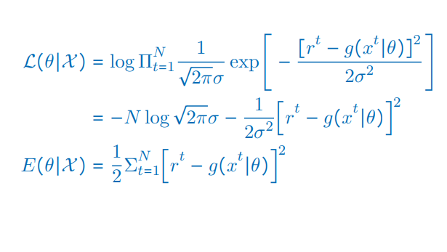


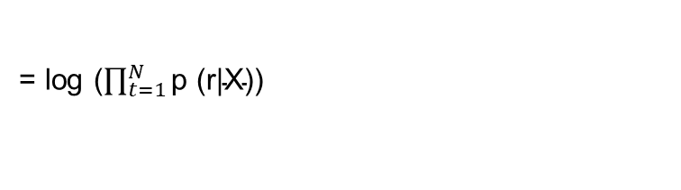
Parametric Regression
<
T
1
>
= log ($\prod_{t=1}^{N}{\text{p}\text{ (}\text{r}\text{|}\text{X}\text{)) }}$
$$We Know the Probability Function:$$
$\text{p}\text{ (}\text{r}\text{|}\text{X}\text{)}$ =

Slide 12


Parametric Regression
<
T
1
>
Breaking Multiplication
This is constant
So we have to minimize this

Slide 13
1
Linear Regression
<
T
1
>

Slide 14
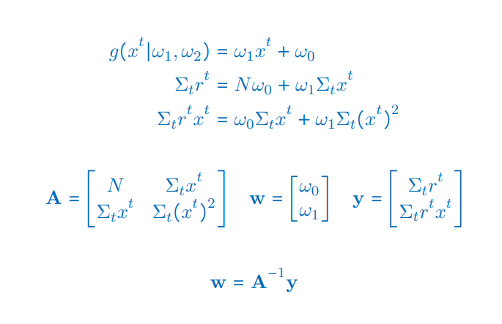
Linear Regression
<
T
1
>
BY differentiating with respect to w₁, w₀

Slide 15

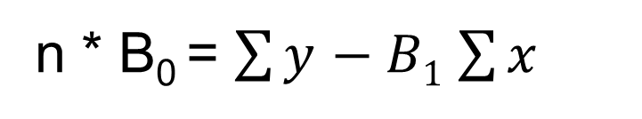
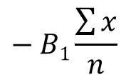
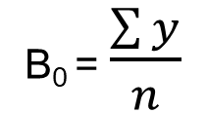
Linear Regression
<
T
1
>
BY differentiating with respect to w₁, w₀
B₀ = $\frac{\sum{y}}{n}$
$$− B1\frac{\sum{x}}{n}$$
n * B₀ = $\sum{y}$ $− B1$ $\sum{x}$

Slide 16
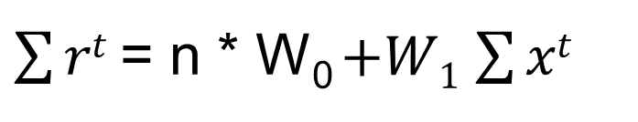
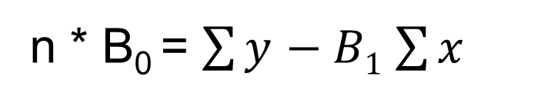
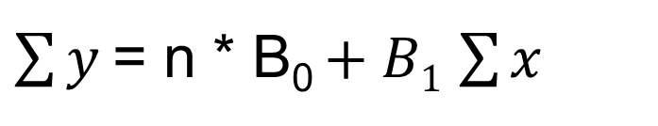
Linear Regression
<
T
1
>
n * B₀ = $\sum{y}$ $− B1$ $\sum{x}$
$\sum{y}$= n * B₀ $+ B1$ $\sum{x}$
$\sum{rt}$= n * W₀ $+W1$ $\sum{xt}$

Slide 17
Linear Regression
<
T
1
>
Y = A * W

Slide 18
Linear Regression
<
T
1
>
W = A⁻¹ * Y

Slide 19
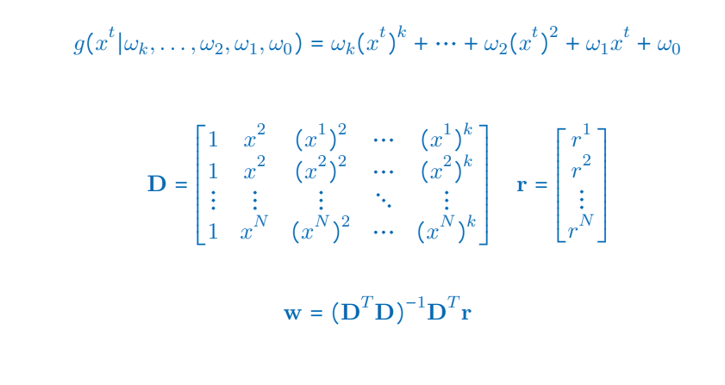
Polynomial Regression
<
T
1
>

Slide 20
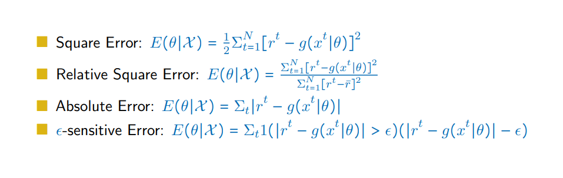
Error Measures
<
T
1
>

Slide 21
1
Bias And Variance
<
T
1
>

Slide 22
Bias And Variance
<
T
1
>
Suppose we have some unknown parameter θ.
We have a dataset D.
So based on data we estimate some values of θ.
d_{i}= d(D)

Slide 23
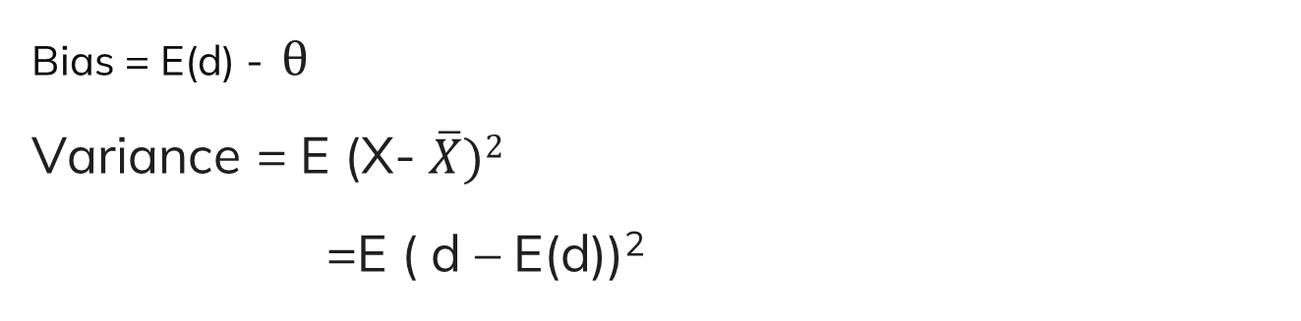
Bias And Variance
<
T
1
>
Bias = E(d) - θ
Variance = E (X- $\overline{X})2$
=E ( d – E(d))²
Variance
E(d)
θ

Slide 24
Bias And Variance
<
T
1
>
Bias = E(d) - θ
Variance = E (X- $\overline{X})2$
=E ( d – E(d))²
Variance
E(d)
θ

Slide 25
Bias And Variance
<
T
1
>
Mean square error of estimator d
E (d - θ)²
⁼ E (d +E(d) –E(d) - θ)²
⁼ E [(d +E(d))² + (E(d) - θ)²- 2 (d +E(d)) * (E(d) - θ)]
= E [(d +E(d))² + E(E(d) - θ)²- 2 E(d +E(d)) * (E(d) - θ)]
= E [(d +E(d))² + (E(d) - θ)²- 2 E(d +E(d)) * (E(d) - θ)]
Constant

Slide 26
Bias And Variance
<
T
1
>
Mean square error of estimator d
E (d - θ)²
⁼ E (d -E(d) +E(d) - θ)²
⁼ E [(d -E(d))² + (E(d) - θ)²- 2 (d -E(d)) * (E(d) - θ)]
= E [(d -E(d))² + E(E(d) - θ)²- 2 E(d -E(d)) * (E(d) - θ)]
= E [(d -E(d))² + (E(d) - θ)²- 2 E(d -E(d)) * (E(d) - θ)]
Constant

Slide 27
Bias And Variance
<
T
1
>
Mean square error of estimator d
= E [(d -E(d))² + E(E(d) - θ)²- 2 E(d -E(d)) * (E(d) - θ)]
= E [(d -E(d))² + (E(d) - θ)²- 2 E(d -E(d)) * (E(d) - θ)]
E(d -E(d))
E(d) – E(E(d))
E(d) – E(d) = 0

Slide 28
Bias And Variance
<
T
1
>
Mean square error of estimator d
= E [(d -E(d))² + E(E(d) - θ)²- 2 E(d -E(d)) * (E(d) - θ)]
= E [(d -E(d))² + (E(d) - θ)²
^{= Varience + Bias2}

Slide 29
Thank You

